Slide 1
Perancangan Sistem Pemrograman
Object-Oriented Analysis & Design, Use Cases
Prepared by Frans Panduwinata, S.Kom, M.T

Slide 2
What is Analysis and Design?
Analysis emphasizes an investigation of the problem rather than how a solution is defined.
For EXAMPLE,
if a new online trading system is desired, how will it be used? What are its functions?
Design emphasizes a conceptual solution (in software and hardware) that fulfills the requirements, rather than its implementation.
For EXAMPLE,
a description of a database schema and software objects.

Slide 3
What is Analysis and Design? (cont)
More analysis-oriented More design-oriented
- what - how
- requirements - logical solution
- investigation of domain

Slide 4
What is OO Analysis and Design?
During oo analysis there is an emphasis on finding and describing the objects or concepts in the problem domain.
For EXAMPLE,
in the case of the flight information system, some of the concepts include Plane, Flight, and Pilot.

Slide 5
What is OO Analysis and Design? (cont)
During oo design there is an emphasis on defining software objects and how they collaborate to fulfill the requirements.
For EXAMPLE,
a Plane software object may have a tailNumber attribute and a getFlightHistory method

Slide 6
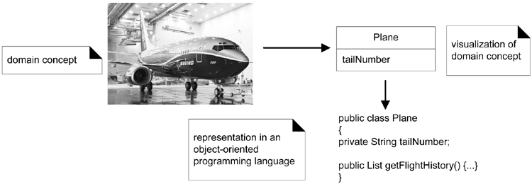
What is OO Analysis and Design? (cont)
EXAMPLE

Slide 7
An Analogy of OOA/D
Business Process
Business Analogy What are the business process
OOA/D Requirements analysis
Associated Documents Use cases
Roles in the Organization
Business Analogy What are the employee roles?
OOA/D Domain analysis
Associated Documents Conceptual model

Slide 8
An Analogy of OOA/D (cont)
Who does What?
Business Analogy Who is responsible for what?
How do they interact?
OOA/D Responsibility assignment,
interaction design
Associated Documents Design class diagrams,
collaboration diagrams

Slide 9
An Example of OOA/D: a “dice game”
Defining Use Cases
Use Cases: narrative descriptions of domain processes in a structured prose format.
Use Case : Play a Game
Actors : Player
Description : This use case begins when the player picks up and rolls the dice. If the dice total seven, they win; otherwise, the lose.

Slide 10
An Example of OOA/D: a “dice game” (cont)
Defining a Conceptual Model
Conceptual model represents concepts in the real-world problem domain.
Player
name
1
Rolls
2
Dice
faceValue
1
2
Plays
1
DiceGame
1
Includes

Slide 11
An Example of OOA/D: a “dice game” (cont)
Defining Collaboration Diagrams
Collaboration diagrams show the flow of messages between instances and the invocation of methods.
play()
:Player
1:r1 :=roll()
d1:Dice
2:r2 :=roll()
d2:Dice

Slide 12
An Example of OOA/D: a “dice game” (cont)
Defining Design Class Diagrams
  Design Class Diagrams illustrates class definitions that are to be implemented in software.
  These will answer:
How do objects connect to other objects?
What are the methods of a class?

Slide 13
An Example of OOA/D: a “dice game” (cont)
Defining Design Class Diagrams (cont)
Player
name
play()
Dice
faceValue
roll()
Rolls
1
2
1
2
Plays
1
DiceGame
initialize
1
Includes

Slide 14
Object vs Function-Oriented
Analysis and Design
  Divide-and-Conquer:
  breaking a problem up into manageable units.
  Structured analysis and design:
  decomposition is primarily by function or process, resulting in a hierarchical breakdown of processes composed of sub-processes.

Slide 15
Object vs Function-Oriented (cont)
Decomposition
The Library
Information System
Structured A/D
Object-oriented A/D
System
Catalog
Librarian
Book
Library
Record
Loans
Add
Resources
Report
Fines
Decompose by objects
or concepts
Decompose by functions or processes

Slide 16
What is the UML?
To quote [Object Management Group, 2003. UML
2.0 Infrastructure Specification]:
The Unified Modeling Language is
a visual language for specifying, constructing
and documenting the artifacts of systems.

Slide 17
What is the UML? (cont)
The UML is a language for modeling.
It does not guide a developer in how to do object-oriented analysis and design, or what development process to follow.

Slide 18
The UML and Development Process
A software development process is
a method to organize the activities related to creation, delivery, and maintenance of software systems.
The UML standardized artifacts and notation, but it does not define a standard development process.

Slide 19
Software Development Life Cycle (SDLC)
A typical SDLC consists of the following phases:
  Requirement gathering and analysis
  Design
  Implementation or coding
  Testing
  Deployment
  Maintenance

Slide 20
Iterative Development Cycle
Development is organized into a series of short, fixed-length (for example, three-week) mini-projects called iterations.
The outcome of each is a tested, integrated, and executable partial system.
Each iteration includes its own requirements analysis, design, implementation, and testing activities.

Slide 21
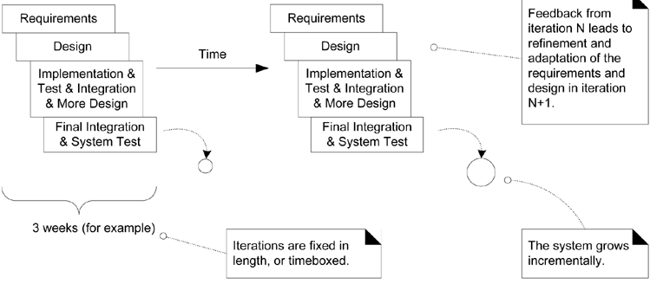
Iterative Development Cycle (cont)
EXAMPLE

Slide 22
Iterative Development Benefits
Less project failure, better productivity, and lower defect rates; shown by research into iterative and evolutionary methods
Early rather than late mitigation of high risks (technical, requirements, objectives, usability, and so forth)
Early visible progress

Slide 23
Iterative Development Benefits (cont)
Early feedback, user engagement, and adaptation, leading to a refined system that more closely meets the real needs of the stakeholders
Managed complexity; the team is not overwhelmed by "analysis paralysis" or very long and complex steps
The learning within an iteration can be methodically used to improve the development process itself, iteration by iteration

Slide 24
Waterfall Lifecycle
In a waterfall (or sequential) lifecycle process there is an attempt to define (in detail) all or most of the requirements before programming.
Why is the Waterfall so Failure-Prone?
It is related to a key false assumption underlying many failed software projects that the specifications are predictable and stable and can be correctly defined at the start, with low change rates.

Slide 25
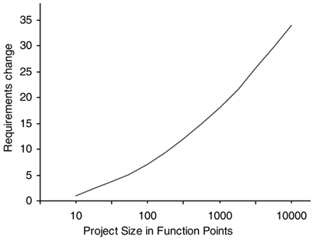
Waterfall Lifecycle (cont)
Percentage of change on software projects of varying sizes
[Jones, C. in Applied Software Measurement].

Slide 26
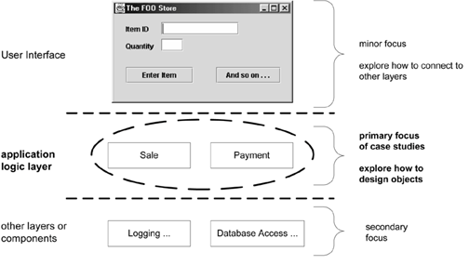
Sample layers and objects in an OO system

Slide 27
Use Cases
Use cases are text stories of some actor using a system to meet goals.
EXAMPLE:
Use case Process Sale:
A customer arrives at a checkout with items to purchase. The cashier uses the POS system to record each purchased item. The system presents a running total and line-item details. The customer enters payment information, which the system validates and records. The system updates inventory. The customer receives a receipt from the system and then leaves with the items.

Slide 28
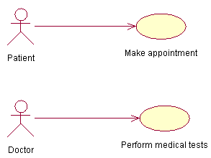
Use Cases (cont)
An actor is something with behavior, such as:
  People (identified by role)
  Computer hardware and devices
  External systems
EXAMPLE of actor and use case:

Slide 29
Use Cases (cont)
A good use case should:
  Describe a sequence of transactions performed by a system that produces a measurable result (goal) for a particular actor.
  Describe the behavior expected of a system from a user’s persective.
  Enable the system analyst to understand and model a system from a high-level business viewpoint.
  Represent the interfaces that a system makes visible to the external entities and the inter-relationships between the actors and the system.

Slide 30
Do(s) and Don’t(s)
Use cases should NOT be used to capture all the details of a system.
The granularity to which you define use cases in a diagram should be enough to keep the use case diagram uncluttered and readable, yet, be complete WITHOUT missing significant aspects of the required functionality.

Slide 31
Do(s) and Don’t(s) (cont)
Use cases are meant to capture "what" the system is, NOT "how" the system will be designed or built.
Use cases should be free of any design characteristics. If you end up defining design characteristics in a use case, you need to go back to the drawing board and start again.

Slide 32
Guideline: How to Find Use Cases
The basic procedure to find use cases is:
  Choose the system boundary.
  Is it just a software application, the hardware and application as a unit, that plus a person using it, or an entire organization?
  Identify the primary actors those that have goals fulfilled through using services of the system.
  Identify the goals for each primary actor.
  Define use cases that satisfy user goals; name them according to their goal (Start the name of use cases with a verb).
  Usually, user-goal level use cases will be one-to-one with user goals, but there is at least one exception, as will be examined.

Slide 33
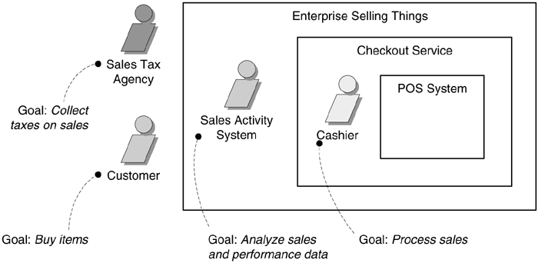
Guideline: How to Find Use Cases (cont)
In iterative and evolutionary development, not all goals or use cases will be fully or correctly identified near the start. It's an evolving discovery.
Primary actors and goals at different system boundaries.

Slide 34
Guideline: What Tests Can Help Find Useful Use Cases?
Which of these is a valid use case?
  Negotiate a Supplier Contract
  Handle Returns
  Log In
  Move Piece on Game Board
There are several rules to help find useful use cases, including:
  The Boss Test
  The Elementary Business Process (EBP) Test
  The Size Test

Slide 35
Guideline: What Tests Can Help Find Useful Use Cases? (cont)
The Boss Test
Your boss asks, "What have you been doing all day?" You reply: "Logging in!" Is your boss happy?

Slide 36
Guideline: What Tests Can Help Find Useful Use Cases? (cont)
The EBP Test
  EBP is a term from the business process engineering field, defined as a task performed by one person in one place at one time, in response to a business event, which adds measurable business value and leaves the data in a consistent state.
  e.g., Approve Credit or Price Order [original source lost].
  The EBP Test is similar to the Boss Test, especially in terms of the measurable business value qualification.
  It doesn't take days and multiple sessions but it is probably between a few minutes and an hour in length.

Slide 37
Guideline: What Tests Can Help Find Useful Use Cases? (cont)
The Size Test
  A use case is very seldom a single action or step; rather, a use case typically contains many steps.
  A common mistake in use case modeling is to define just a single step within a series of related steps as a use case by itself, such as defining a use case called Enter an Item ID.

Slide 38
Guideline: What Tests Can Help Find Useful Use Cases? (cont)
EXAMPLE: Applying the Tests
  Negotiate a Supplier Contract
    Much broader and longer than an EBP. Could be modeled as a business use case, rather than a system use case.
  Handle Returns
    OK with the boss. Seems like an EBP. Size is good.
  Log In
    Boss not happy if this is all you do all day!
  Move Piece on Game Board
    Single step fails the size test.

Slide 39
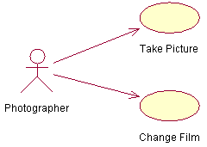
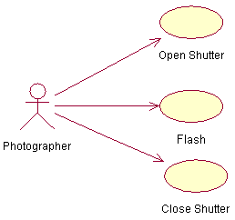
Guideline: What Tests Can Help Find Useful Use Cases? (cont)
EXAMPLE:
Photographer and Camera
Correct
Incorrect

Slide 40
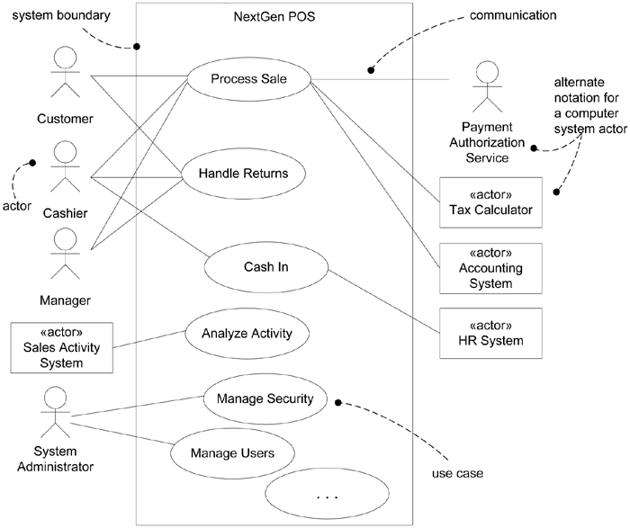
Applying UML: Use Case Diagrams
EXAMPLE:
NextGen POS

Slide 41
Scenarios
A scenario is a specific sequence of actions and interactions between actors and the system; it is also called a use case instance.
It is one particular story of using a system, or one path through the use case.
For EXAMPLE:
The scenario of successfully purchasing items with cash, or the scenario of failing to purchase items because of a credit payment denial.

Slide 42
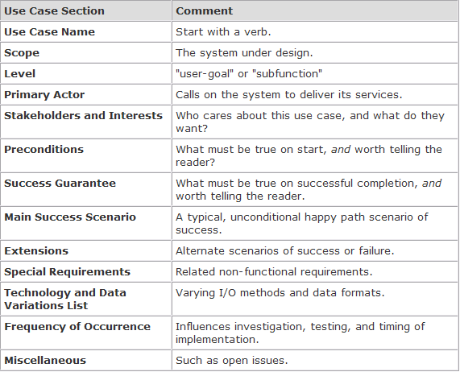
Scenarios (cont)
Fully Dressed Style

Slide 43
Scenarios (cont)
A user-goal level use case
  The common kind that describe the scenarios to fulfill the goals of a primary actor to get work done;
  It roughly corresponds to an elementary business process (EBP) in business process engineering.
A subfunction-level use case
  Describes substeps required to support a user goal, and is usually created to factor out duplicate substeps shared by several regular use cases (to avoid duplicating common text);
  An EXAMPLE is the subfunction use case Pay by Credit (“include” relationship) , which could be shared by many regular use cases.

Slide 44
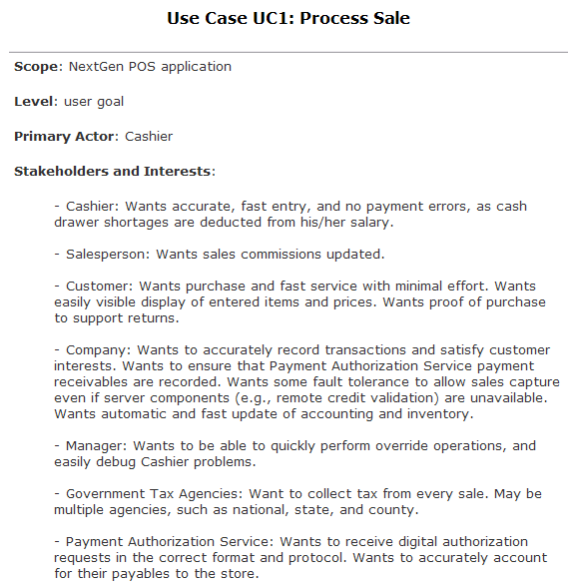
Scenarios (cont)
EXAMPLE:
Process Sale

Slide 45
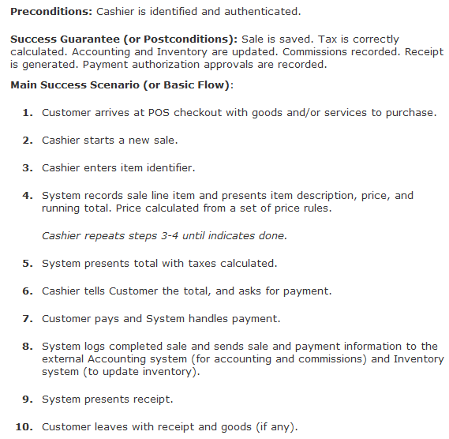
Scenarios (cont)
EXAMPLE: (cont)
Process Sale

Slide 46
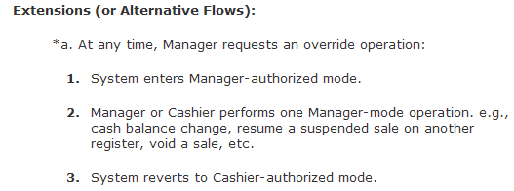
Scenarios (cont)
EXAMPLE: Process Sale, Fully Dressed Style

Slide 47
Scenarios (cont)
EXAMPLE:
Brief description of the Check Order Status use case
Use Case | Check Order Status
Use Case ID | UC-400
Actor | Customer Service Assistant
Description | The Customer Service Assistant enters the ID of the member. The Customer Service Assistant selects a sales order of the member.The system displays the status of the sales order.

Slide 48
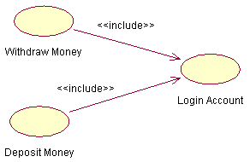
Relationship
Include
  In an include relationship, a use case includes the functionality described in the another use case as a part of its business process flow.
  include relationship are used when two or more use cases share some common portion in a flow of events.
EXAMPLE:

Slide 49
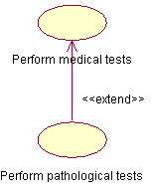
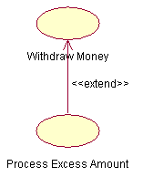
Relationship (cont)
Extend
  In an extend relationship between two use cases, the child use case adds to the existing functionality and characteristics of the parent use case.
  extend relationship are used when two use cases in similar, but one does a bit more than the other.
EXAMPLE:

Slide 50

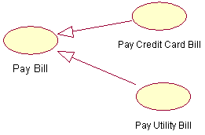
Relationship (cont)
Generalizations
The child use case in the generalization relationship has the underlying business process meaning, but is an enhancement of the parent use case.
EXAMPLE:

Slide 51
Relationship (cont)
Difference between a generalization relationship and an extend relationship:
  In generalization relationship, the parent use case can be replaced by the child use case without breaking the business flow.
  On the other hand, the parent use case in an extend relationship cannot be replaced by the child use case.

Slide 52
Case Study
For our case study, we will be the architects assigned the task
of constructing the design elements for a system that can be
used to manage coursees/classes for an organization that
specializes in providing training.
Let us name the system that we will be designing as the Courseware Management System.

Slide 53
Case Study (cont)
The organization offers a variety of courses in a variety of
areas such as learning management techniques and
understanding different software languages and technologies.
Each course is made up of a set of topics.
Tutors in the organization are assigned courses to teach
according to the area that they specialize in and their
availability.

Slide 54
Case Study (cont)
The organization publishes and maintains a calendar of the
different courses and the assigned tutors every year.
There is a group of course administrators in the
organization who manage the courses including course
content, assign courses to tutors, and define the course
schedule.

Slide 55
Case Study (cont)
The training organization aims to use the Courseware
Management System to get a better control and visibility to the
management of courses as also to streamline the process of
generating and managing the schedule of the different
courses.

Slide 56
Case Study (cont)
First, let us list the potential actors:
  Courses and Topics that make up a course
  Tutors who teach courses
  Course administrators who mange the assignment of the courses to tutors
  Calendar or Course Schedule is generated as a result of the
  Students who refer to the Course schedule or Calendar to decide which courses they wish to take up for study

Slide 57
Case Study (cont)
The entities that perform action will be the actors for the Courseware Management System. In the above list, the actors that we can identify are:
  Tutors
  Course administrators
  Students

Slide 58
Case Study (cont)
Next, let us identify the potential business processes in the Courseware Management System. The primary business flows in the system are:
  Manage courses
  Manage course assignments

Slide 59
Case Study (cont)
To manage courses, the actor needs to have
  the ability to view existing courses,
  manage the course information for a course, such as duration and so forth, and also
  manage the addition or removal of topics for a course.
So, within the "Manage courses" use case, we can identify the following sub processes:
  View courses
  Manage topics for a course
  Manage course information

Slide 60
Case Study (cont)
The “Manage course assignment " use case can be refined into smaller discrete processes such as
  viewing the course calendar,
  viewing tutors,
  managing the tutor information of tutors, and
  assigning courses to tutors.
Now, the use cases that we have identified within the "Manage course assignment" use case are:
  View course calendar
  View tutors
  Manage tutor information
  Assign courses to tutors

Slide 61
Case Study (cont)
Our final list of use cases for the courseware management system will now be:
  View courses
  Manage topics for a course
  Manage course information
  View course calendar
  View tutors
  Manage tutor information
  Assign courses to tutors

Slide 62
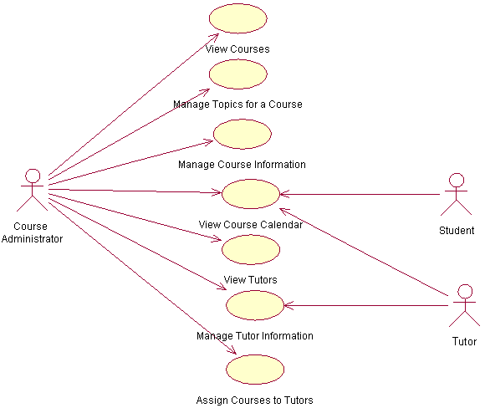
Exercises
Use case diagram of Courseware Management System
TASK:
Modify this use case for more detail use case (include, extend relationship, etc)
Create use case scenario for each use case.
NOTE:
Use your own assumptions

